Slide 1
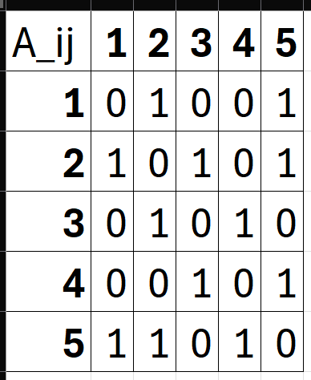
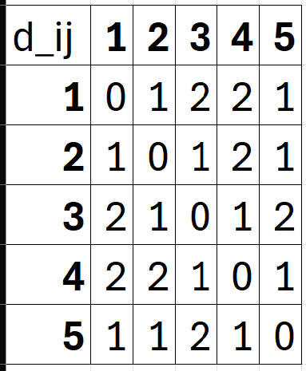
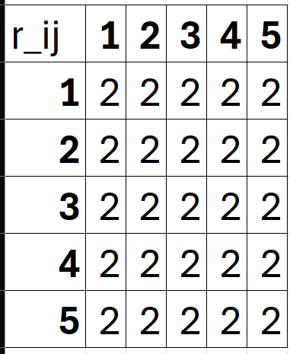
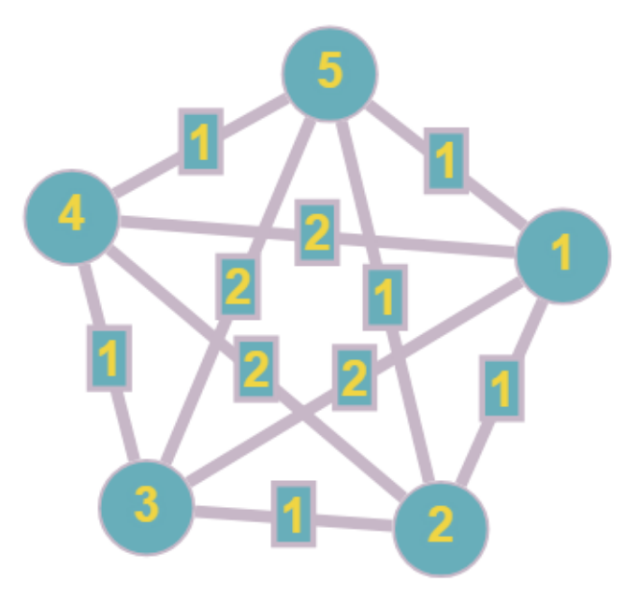
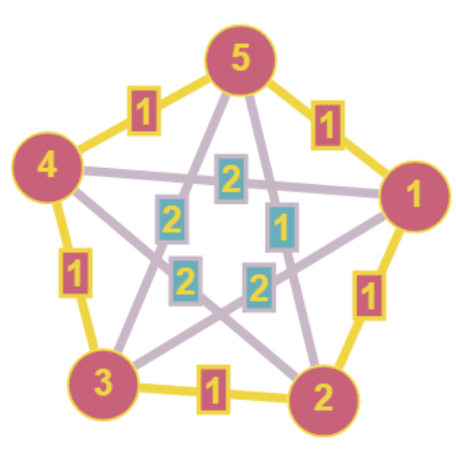
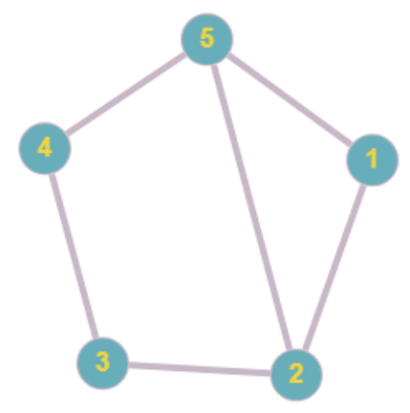
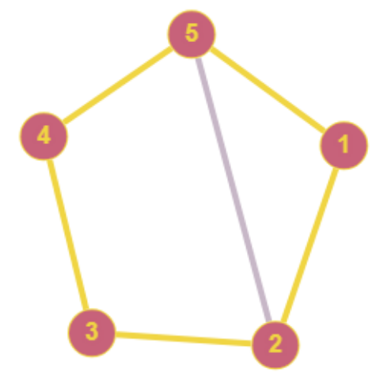
Transformation – Rudrata Cycle to Reliable Network
Input for Reliable Network –
Distance Matrix, dij
Connectivity requirement matrix, rij
Budget, b = 5 (number of nodes)
Input for Rudrata Cycle –
Adjacency matrix, Aij
Transformation
Time Complexity –
O(n^2)
Transforming problem
Transforming solution
(red and yellow)

